Slide 1

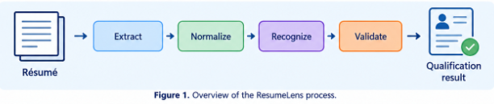
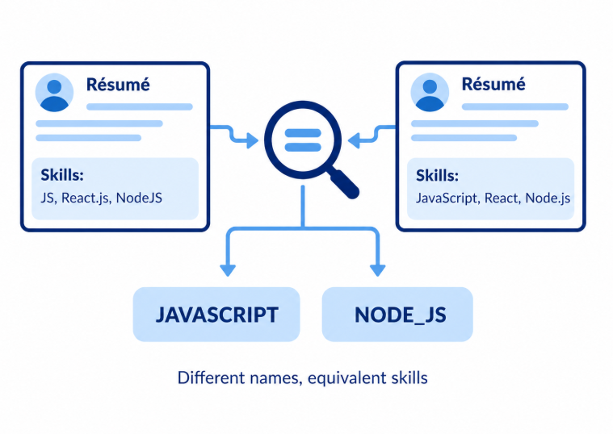
ResumeLens
Santiago Cabal and Nicholas Solis
Icesi University-Barberi Faculty
Introduction
Methods
Conclusions
Recruiters often review many résumés with different formats and ways of describing skills. ResumeLens addresses this challenge by using formal language models to process résumé information and evaluate qualifications against professional profiles.
ResumeLens follows a four-stage pipeline based on formal language theory.
1. Information Extraction
Regular expressions identify relevant data, including contact details, education, experience, and technical skills.
2. Skill Normalization
Finite-state transducers convert different names and abbreviations into standard labels. For example, “JS” becomes “JAVASCRIPT.”
3. Profile Recognition
Deterministic finite automata (DFAs) evaluate the normalized skills against predefined qualification patterns for four profiles: Full Stack Developer, Machine Learning Engineer, Data Engineer, and Devops.
4. Candidate Profile Validation
A context-free grammar, implemented with textX, checks whether the structured candidate profile follows the required syntax. The system then generates a Markdown summary.
ResumeLens demonstrates how formal language models can work together to support consistent résumé screening. Regular expressions extract information, finite-state transducers normalize skill names, finite automata recognize qualification patterns, and context-free grammars validate candidate profile structures.
The implemented test cases cover skill variations, profile acceptance and rejection, and structural validation. Their execution will determine whether the results support the main hypothesis. ResumeLens provides a structured and reproducible way to check defined qualifications without ranking candidates or making hiring decisions.
References
Credits: Oregon State University Library text and University of Southern California Library graphic.

